Slide 1
Part 2: Developing AI

Slide 2
Microsoft AI Stack
Developing AI
Edge
Models deployed to containers running on thin devices
App Models
Experimentation
Libraries used to host and run AI on devices or in apps (ML.NET, WinML)
Rapid iterations of attempts, failures and success
Digital Experience
Sprint (4w)
Cognitive Services
Configurable AI accessible via an API call
UX Development
Backlog retirement of screens and other UX in sprint
AI Platform
AI scale power for configuring, training and creating models

Slide 3
Option 1: Self-contained slide as summary
Microsoft Data+AI solution
Extensible AI services
Open AI tools
Powerful Infrastructure
On-premises
Edge
Cloud
AI Built-in
The Trusted Cloud
AI Business Solutions
Over 650,000
Partners
Rapid time to market with an
agile and productive AI platform
Gain transformative insights with a
comprehensive platform for your data estate
Innovate with confidence with
enterprise-proven solutions
Notes:
We have a unique value prop and we are differentiated in 3 core areas.
First Let’s start with the platform. Our AI platform provides the most rapid time to market – period. We offer the most choice, flexibility, and agility with services that make AI development productive. Take IBM for example - we can build a PoC with our platform in weeks if not days, while IBM takes months.
Our second area of differentiation is our comprehensive data platform. There’s no AI without data, and only Microsoft can bring AI to wherever the data is – on premises, on the edge, in the cloud and everywhere in between. Unlike Google or Amazon who tell customers to move their data first – we don’t force our customers to change their data estate, we meet them where they are – we offer flexibility vs rigidness.
Lastly, we are enterprise-proven. We provide enterprise proven solutions with all the benefits that Azure brings - security, privacy, reliability, and we are backed by a vibrant partner community. We know how to create secure and reliable solutions that can scale to your needs. Even our business model is tied to your success. We are successful when you are successful. We also have a huge partner ecosystem that can help you scale. You don’t need us to build your solution. So you can do it on your own, rely on our partner ecosystem or rely on us.

Slide 4
The Microsoft AI platform: Azure & AI
Option 1: High level intro
Services
Tools
Infrastructure
Notes:
It’s all about three pieces: our Azure services, our infrastructure, and our tools.

Slide 5
Option 2: Detailed intro
Microsoft AI Platform
Azure AI Services
PRE-BUILT AI
CONVERSATIONAL AI
CUSTOM AI
CODING & MANAGEMENT TOOLS
Cognitive Services
Tools
Bot Service
Azure Machine Learning
VS Tools for AI
Azure ML Studio
Azure ML Workbench
Others (PyCharm, Jupyter Notebooks…)
Azure Infrastructure
DEEP LEARNING FRAMEWORKS
AI ON DATA
AI COMPUTE
3rd Party
Cosmos DB
SQL
DB
SQL
DW
Data Lake
Spark
DSVM
Batch AI
ACS
IoT Edge
Cognitive Toolkit
TensorFlow
Caffe
CPU, FPGA, GPU
Others (Scikit-learn, MXNet, Keras, Chainer, Gluon…)
Notes:
Let’s start with AI services. We provide the most comprehensive set of AI services for any developer, any organization, and any scenario.
We have pre-built AI services with Cognitive Services. We were the first ones in the market to release this concept of AI as a service, and we are leaders in terms of developer adoption, number of services and capabilities provided. We have the unique capability for developers to customize these services for any particular scenario, something our competitors are only in the very early stages of.
We also have the most powerful bot platform, fully integrated with these services, enabling organizations to embrace conversational AI and connect them with their business processes.
And finally, we also provide a full solution for custom AI with Azure Machine Learning, covering the entire lifecycle of AI development in the Enterprise, from training to deployment.
All of this is based on the powerful infrastructure provided by Azure. We are taking all that power and applying it to AI, from CPU compute to GPU and next, FPGA.
We have a huge lever in the market with our tools. We’re taking the power of Visual Studio and Visual Studio Code to AI development. We are unique in our ability to provide a full solution across services and tools to make AI development productive and approachable.
Every developer can be an AI developer with this unique combination.
Lastly, we take an open approach to this solution. These tools and services work across any framework, we don’t make the decision for you, so you are not locked in to a vendor.

Slide 6
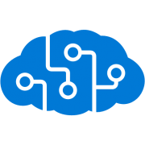












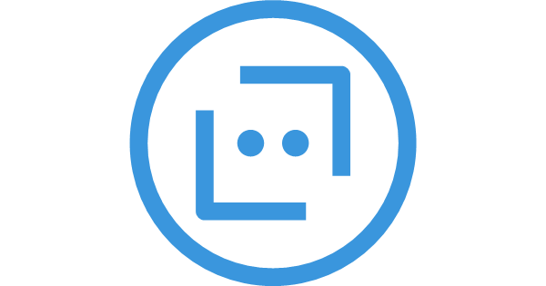




Moving from Data to Knowledge
Data Estate
Knowledge
Cognitive Services
Unstructured
Real-Time Streaming
Data Factory
Web Services
Connected Customer
Devices
Events
Weather
Twitter
Data Warehouse
Stream Analytics
Dashboards
Data Catalog
Apps / Devices
Data Lake
Machine Learning
Power BI
Sales
Structured
Historical
Event Hub
Bot Framework`
Sales
Marketing
Profile
Data Lake Analytic
Operations
Ingest
Store
Process
View
Project
Action

Slide 7
Knowledge Mining
Companies have accumulated mass quantities of structured and unstructured data and content over many years. Knowledge Mining give these companies the capability to extract knowledge from this data and content.
Using a continuous process that ingests raw data and content Knowledge Mining can enrich this information and create structured insight that enables you to explore the underlying data.

Slide 8
What is knowledge mining?
Unlock valuable information lying latent in all your content
Form 5471

Slide 9
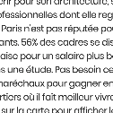


Knowledge mining with Azure Search
Documents
Cutting-edge AI
Fully text-searchable rich index
Key Phrase extraction
Location entity extraction
Sentiment analysis
Organization entity extraction
Persons entity extraction
Language detection
Face detection
Celebrity recognition
Tag extraction
Custom skills
Landmark detection
Printed text recognition

Slide 10
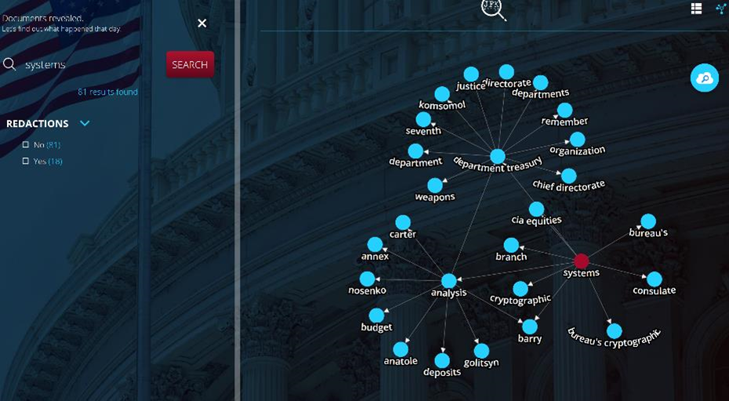
Knowledge Mining Demo
JFK Files Demo

Slide 11

Knowledge Mining: How the demo was built
INGEST
STORE
AI
SERVE
Media (unstructured)
Natural Language Processing Image Processing Custom Models
Azure Data Factory
Azure Blob Storage
Cognitive Search (Azure Search)
Cosmos DB
Azure App Service
Web & mobile apps
Files (unstructured)

Slide 12

Azure AI services
Bot Service
Spider
Accelerated development for conversational AI.
Cognitive Services
Vision, speech, language, knowledge and search pre-trained services customizable for any scenario.
Azure Machine Learning
Experimentation and management services for creating AI models with productivity.
Notes:
We have the most powerful bot platform combined with customizable Cog Services. Enterprises can easily build powerful agents to streamline work processes and integrate in their existing data estate – whether on premises, edge, cloud or hybrid. AML enables enterprises to further customize their solutions based on their unique needs. We were the first organization to surpass human parity for both vision and speech.

Slide 13
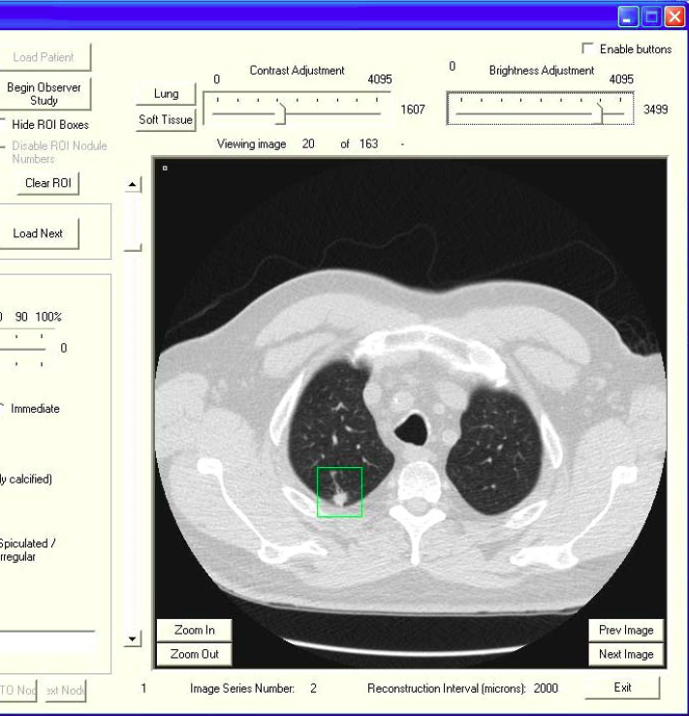
AI infrastructure
AI on data
Built-in AI across your data estate.
AI compute
Flexible compute infrastructure from virtually infinite cloud scale to the edge .
AI core infrastructure
The AI supercomputer: CPU, GPU, and (coming next) FPGA.
Notes:
Our second area of differentiation is our comprehensive data platform. There’s no AI without data, and only Microsoft can bring AI to wherever the data is – on premises, on the edge, in the cloud and everywhere in between.
All of this is based on the powerful infrastructure provided by Azure. We are taking all that power and applying it to AI, from CPU compute to GPU and next, FPGA.

Slide 14
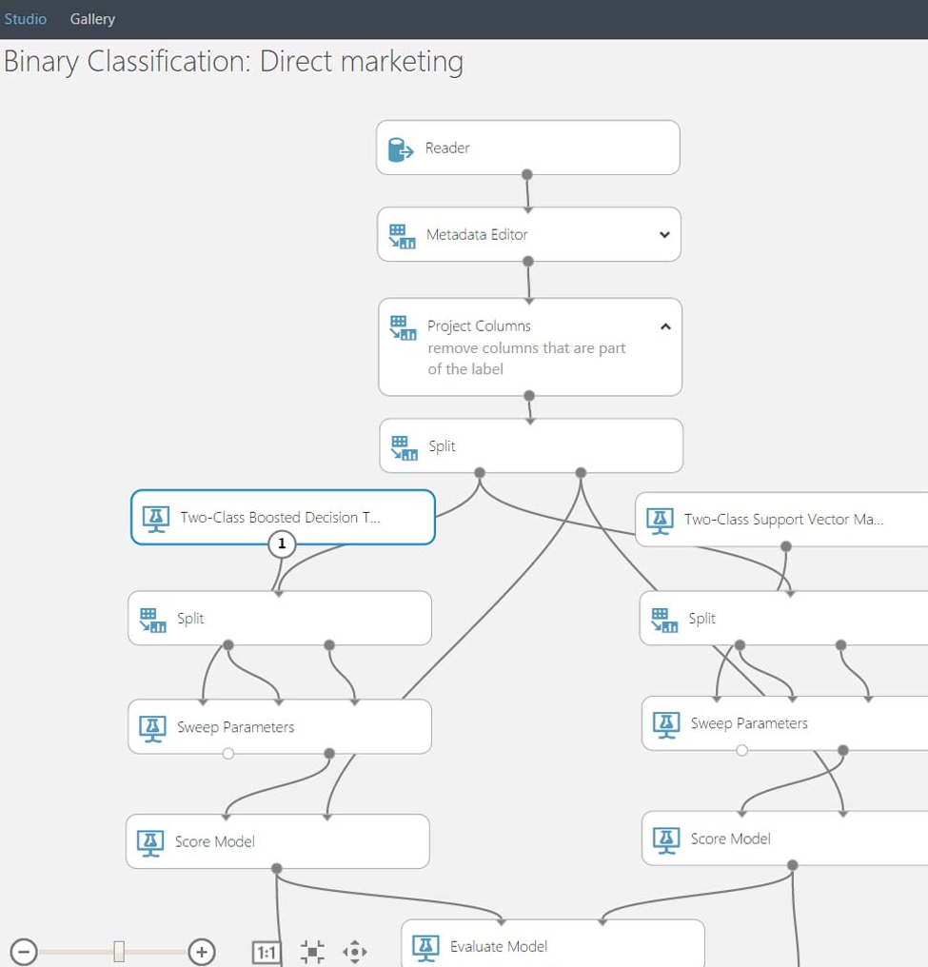
Tools
Visual Studio Tools for AI
Boost productivity with code-centric AI development and Azure integration.
Azure Machine Learning Servicesw
Full lifecycle support for AI and data wrangling productivity.
Azure Machine Learning Studio
Drag and drop machine learning development for any skillset.
Open deep learning framework support
Full support for Cognitive Toolkit, TensorFlow, Caffee and others.
Open standard for deep learning (ONNX).
Notes:
The same is true for Tools. We have a huge lever in the market with our tools. We’re taking the power of Visual Studio and Visual Studio Code to AI development. No other vendor provides a full solution across services and tools to make AI development productive and approachable.

